Slide 1

You are wel- come to the English class .

Slide 2
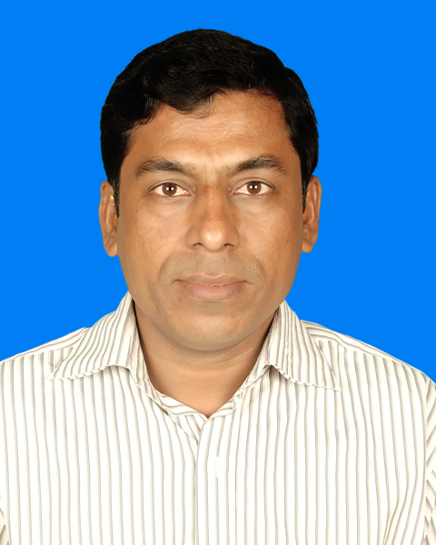
Class introducing
Subject : English lst
Class : Nine
Unit : Three
Lesson : Five
Page : 41
Time: 50 ( minutes)
Dated : 06 / 02 / 2014 A.D.
01717-081877 / 01947-105663
This is --- Md.Abu Baset Bhuiyan (B.A.B.Ed.)
Assistant teacher (English)
Haque Saheb High School ,
Savianagar , Austagram , Kishoregonj .

Slide 3
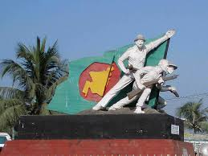
What is it?
It is the statue of freedom fighters liberation war of Bangladesh in 1971 .

Slide 4

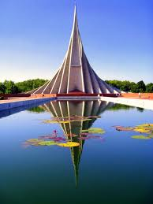
What can you see in the picture ?
The National Memorial of Bangladesh

Slide 5
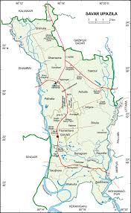
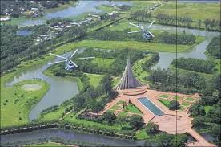
Where is it ?
At Savar
National
Memorial

Slide 6
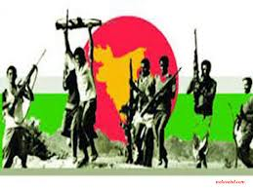
Why was it built ?
It was built for honour and dignity to the freedom fighterS of our country.

Slide 7
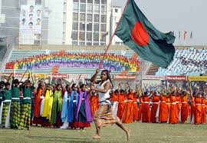
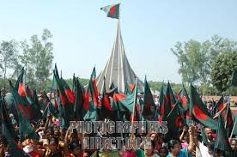
So , we are discussing about our---
Independence Day

Slide 8
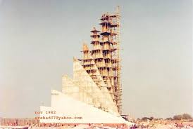
“It is built with concrete but made of blood.”
It was made in 1972 .

Slide 9

Objectives
By the end of this lesson students will able to---
(a) ask and answer questions about this day .
(b) read a text on the Independence Day.
(c) locate at Savar .
(d) know celebration day begins with 31 gunshort .
(e) Know about the biggest festival day etc.

Slide 10
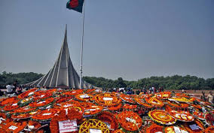
Vocabulary
Flora:
Decorated with / Depicting flowers .
We put our flora wreath in front of it.

Slide 11
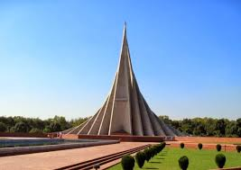
Exciting:
Enthusiasm / Arousing great interest.
The National Memorial looks very exciting .

Slide 12
Now,let’s go out visiting our National Memorial at Savar.

Slide 13
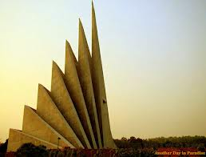
7
150
6
5
4
3
0
2
1
0
130

Slide 14
Match the words with their meaning.
Words
Meaning
Fervour
a strong feeling of excitement.
Alike
in a similar way .
Spectator
a person who is watching an event.
Displays
acts of performing skills .
Illuminate
to decorate a building with bright light .

Slide 15
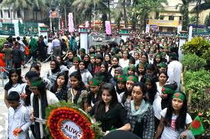
Pair work
Choosing
Our biggest state festival is---
a. Victory Day.
b. Shaheed Dibosh.
c. Pahela Baishakh .
d. Independence Day .
That is--- d. Independence Day

Slide 16
1. The celebratoin of Independence Day begins with---
processions .
gunshots .
c. placing wreaths at the National Memorial .
d. the display of parades by defence forces .
b. gunshots.

Slide 17
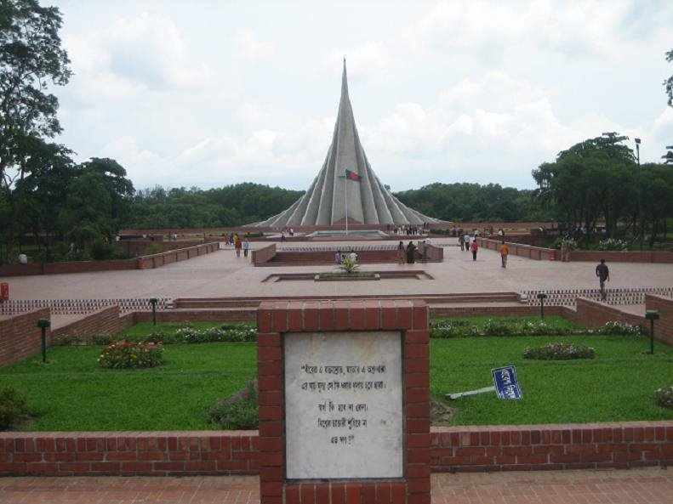
What are they ?
These are several graves of freedom fighters .

Slide 18
Group work
Some questions---
Group -A
How do we celebrate the day?
Ans: We celebrate the day with great enthusiasm and fervour.
Group-B
Where is located The National Parade Ground?
Ans: It is located near The National Parliament .
Group-C
When are all major public building illuminated ?
Ans: All major public building are illuminated in the evening .

Slide 19
Home work
Now write in briefly , how celebrated this year’s Independence Day in your school .

Slide 20

My dear students---
Thank you

